Slide 1
React + Redux
Philip Falkenberg
Last Updated: 10/31/17

Slide 2
What is Redux?
Redux is a design pattern that allows efficient and predictable state management in an application.
It is language/framework agnostic. Works in vanilla JS, Angular, or React.
It uses unidirectional data flow to change and update the UI.

Slide 3
Redux Design Principles
Actions
Returns either payload data or a function
Reducers
Handles action data and initiates state changes
Single Store for State
Immutable state tree JSON object
Dispatcher
Publish Action data to Reducers
Three Principles
Single Source of truth
State is read-only
Changes are made with pure functions

Slide 4
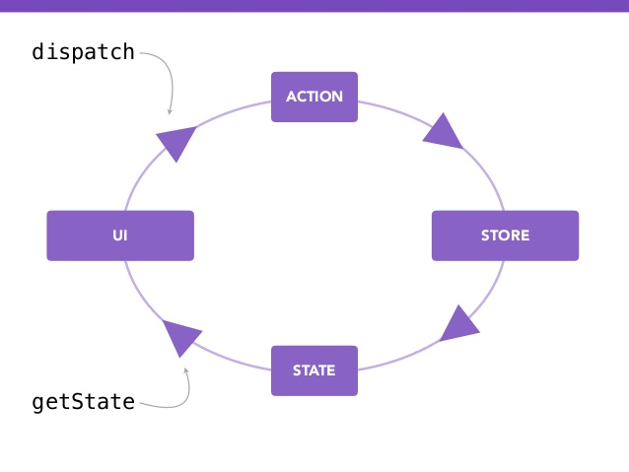
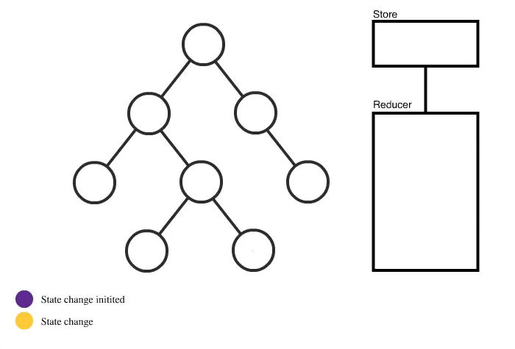
Redux Visualization

Slide 5
Redux Time Travel
0s
30s
STORE
isOn: false
STORE
isOn: true
STORE
isOn: false
View
Switch: TOGGLE()
Action Data Stack
Action: TOGGLE, isOn: false
ACTION
DISPATCH
REDUCER
Action: TOGGLE, isOn: true
Action: TOGGLE, isOn: false

Slide 6
References
https://medium.com/dailyjs/when-do-i-know-im-ready-for-redux-f34da253c85f
http://redux.js.org/
https://swizec.com/blog/animating-with-react-redux-and-d3/swizec/6775
https://redux-minimal.js.org/
https://code.tutsplus.com/tutorials/introduction-to-webpack-part-1--cms-25791
https://medium.com/@rajaraodv/webpack-the-confusing-parts-58712f8fcad9

